Slide 1
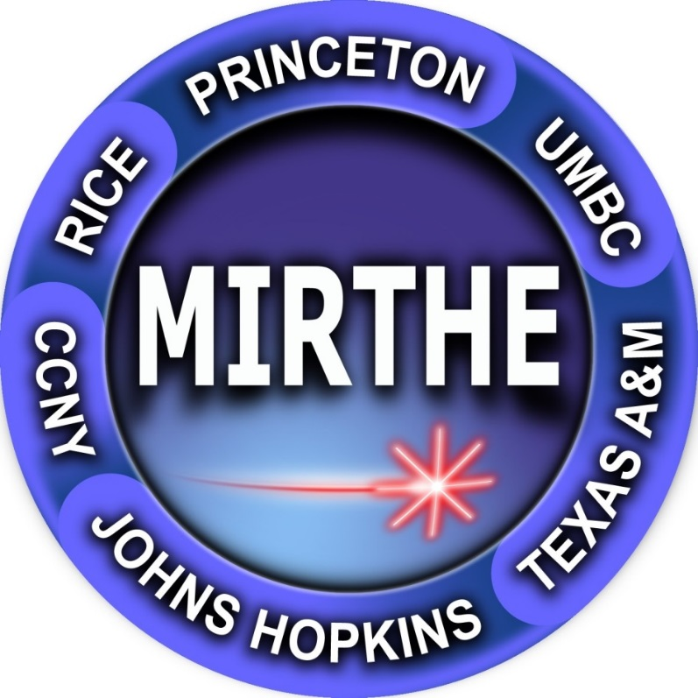

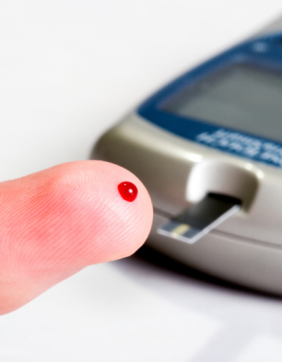
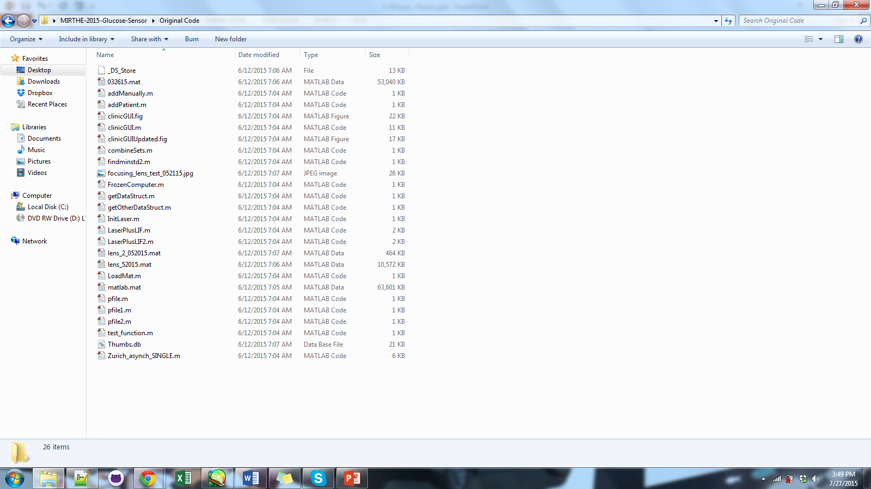
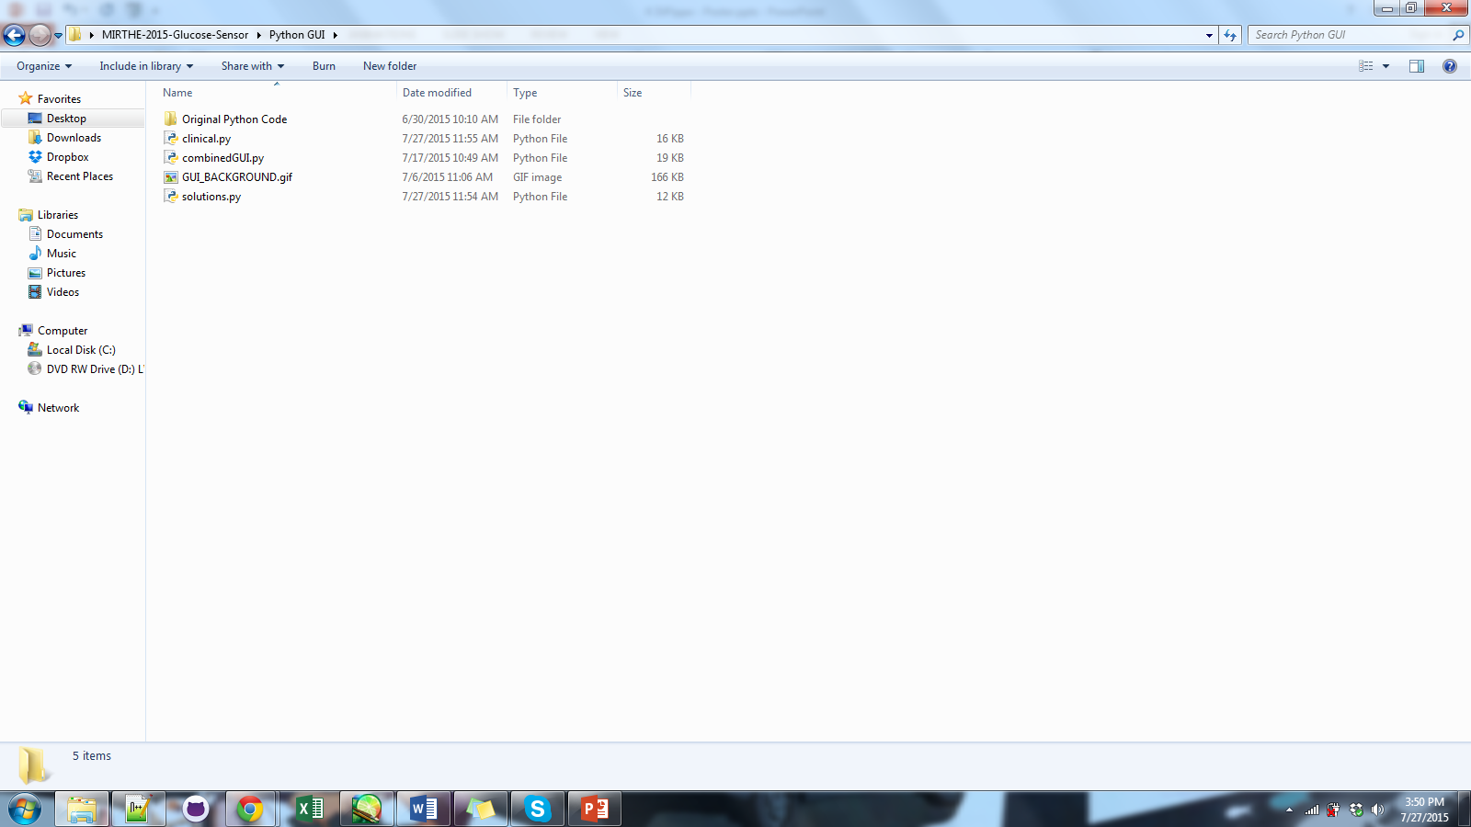
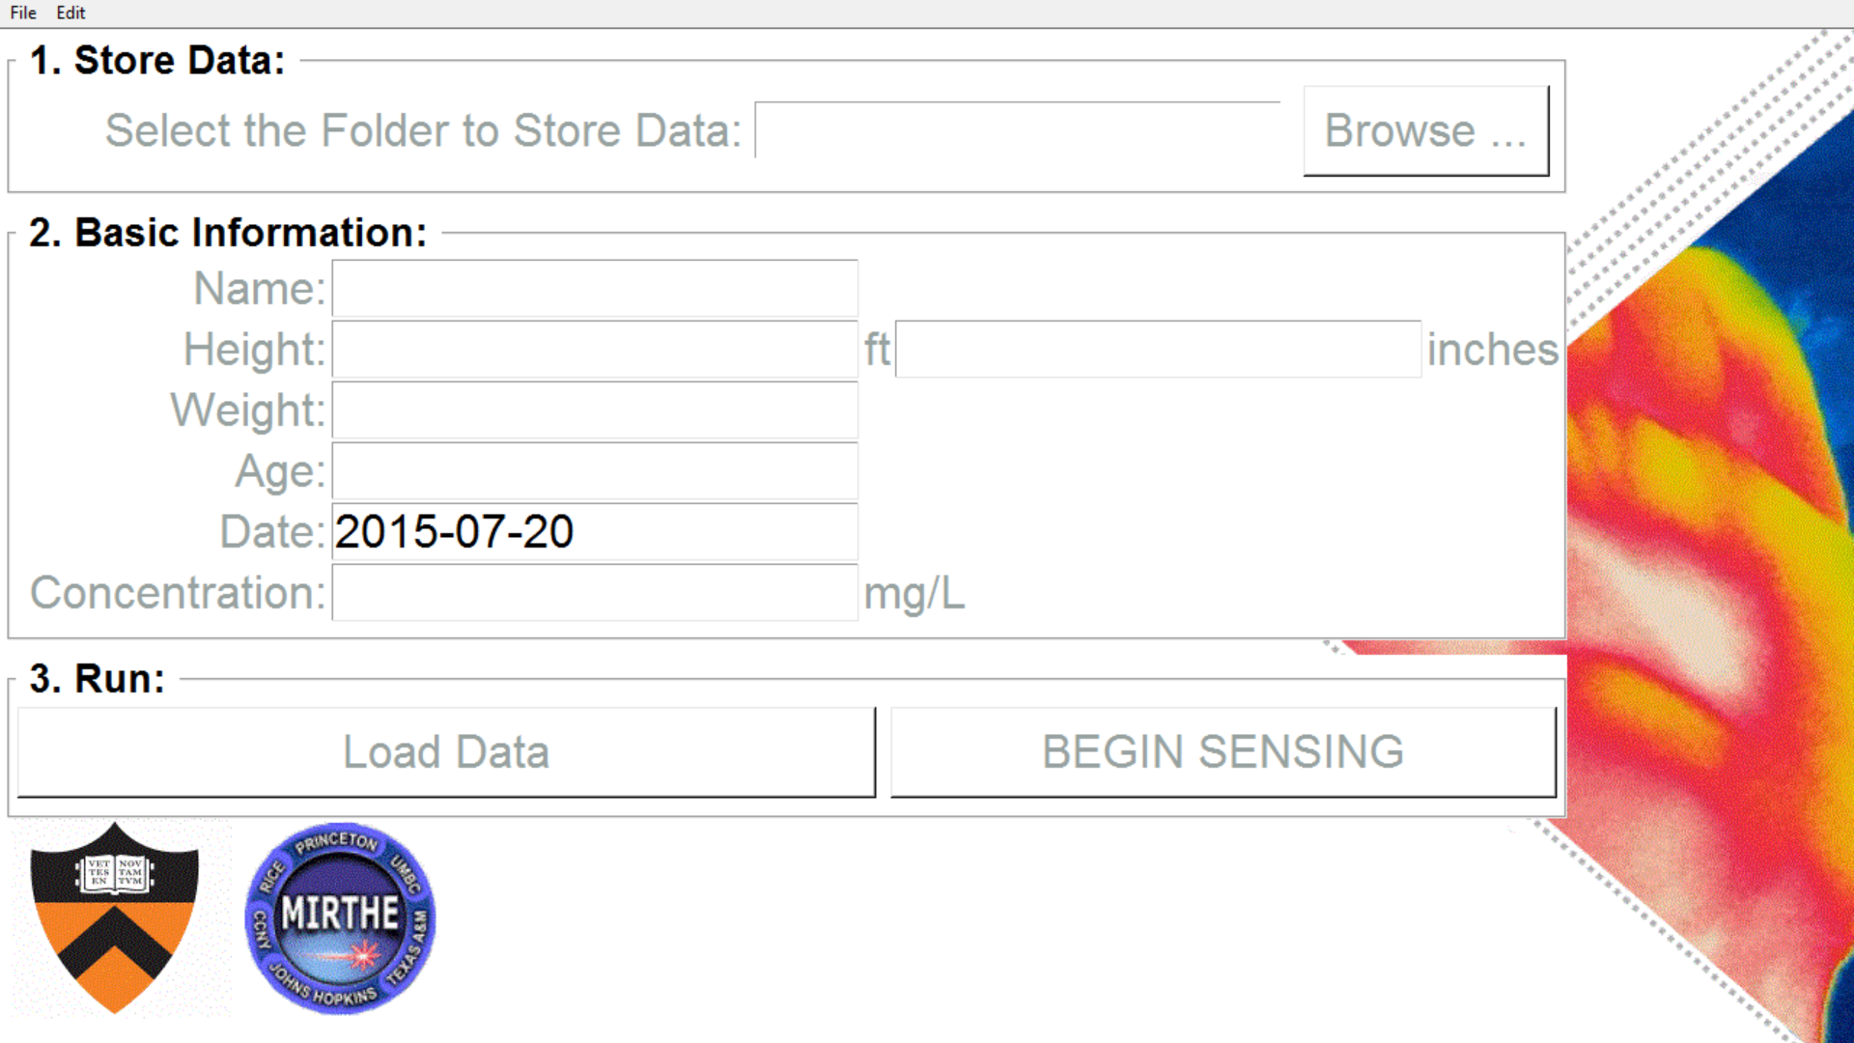
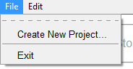
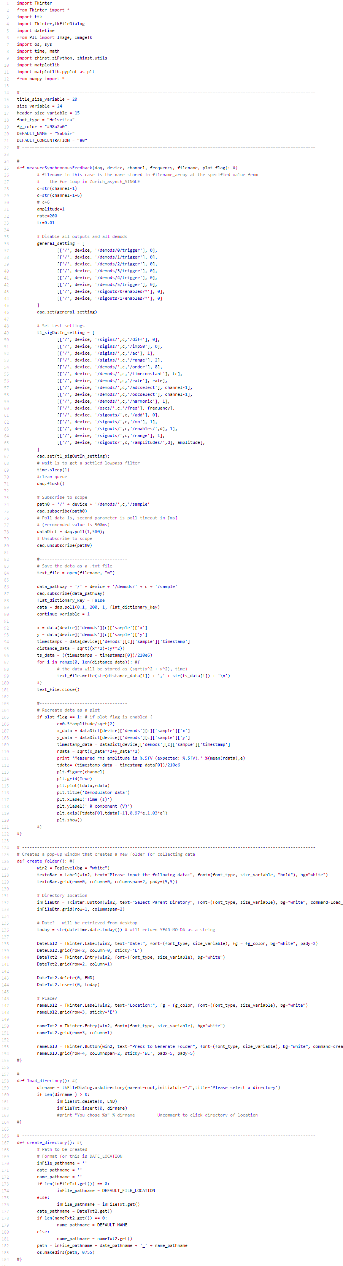
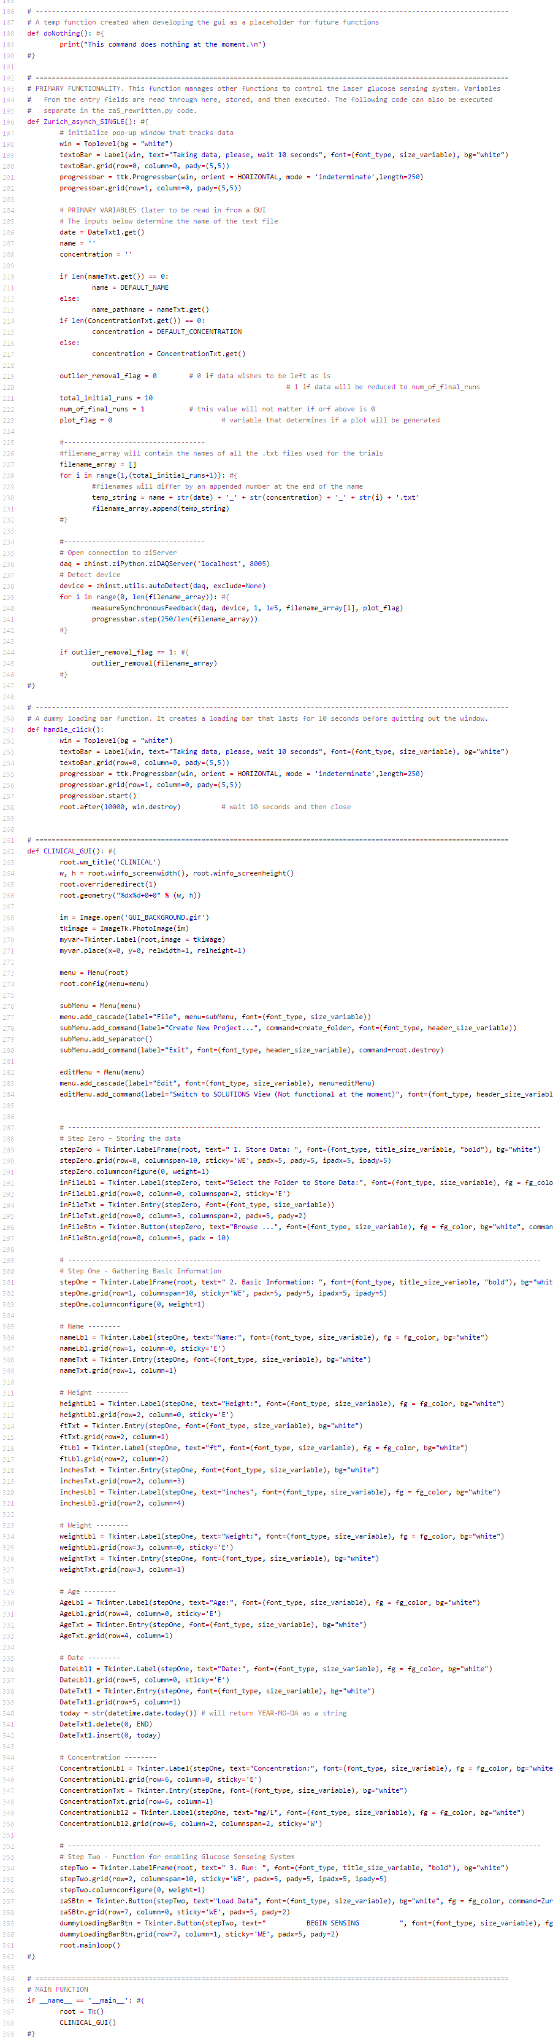
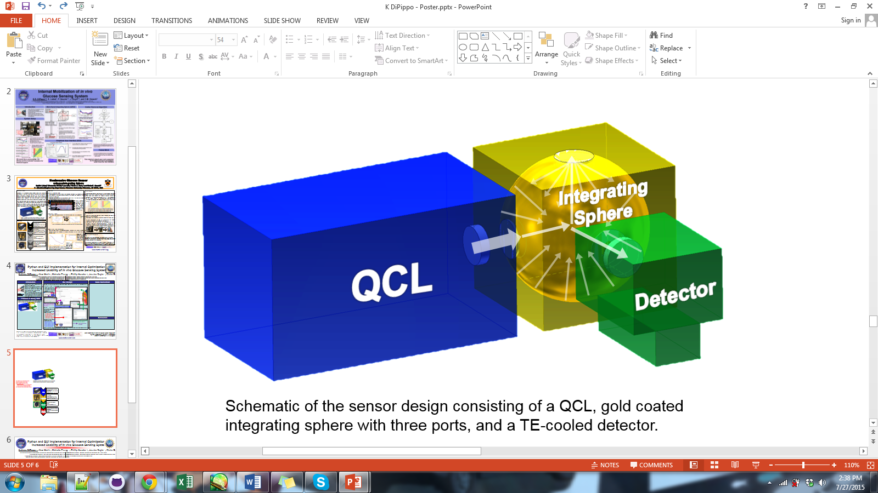
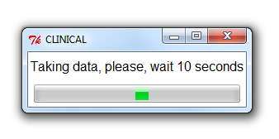
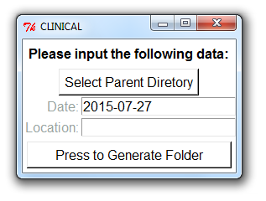
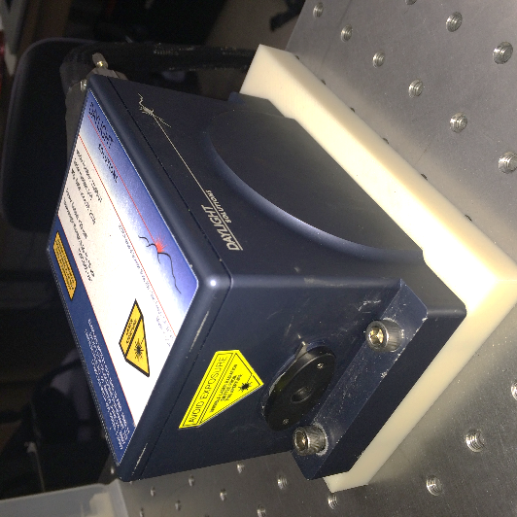
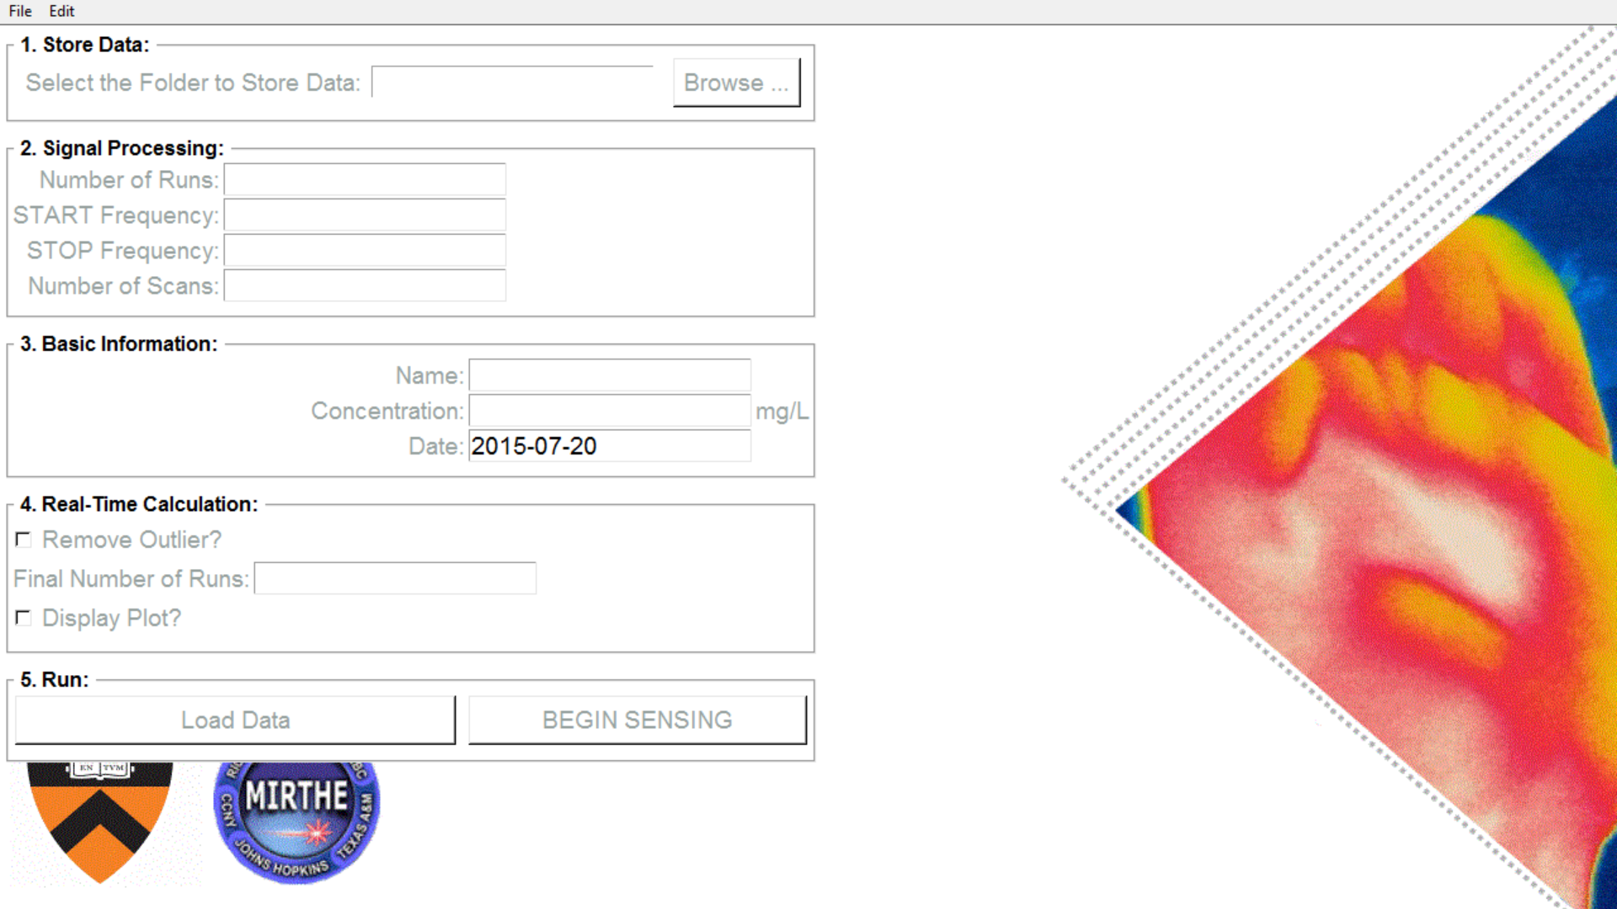
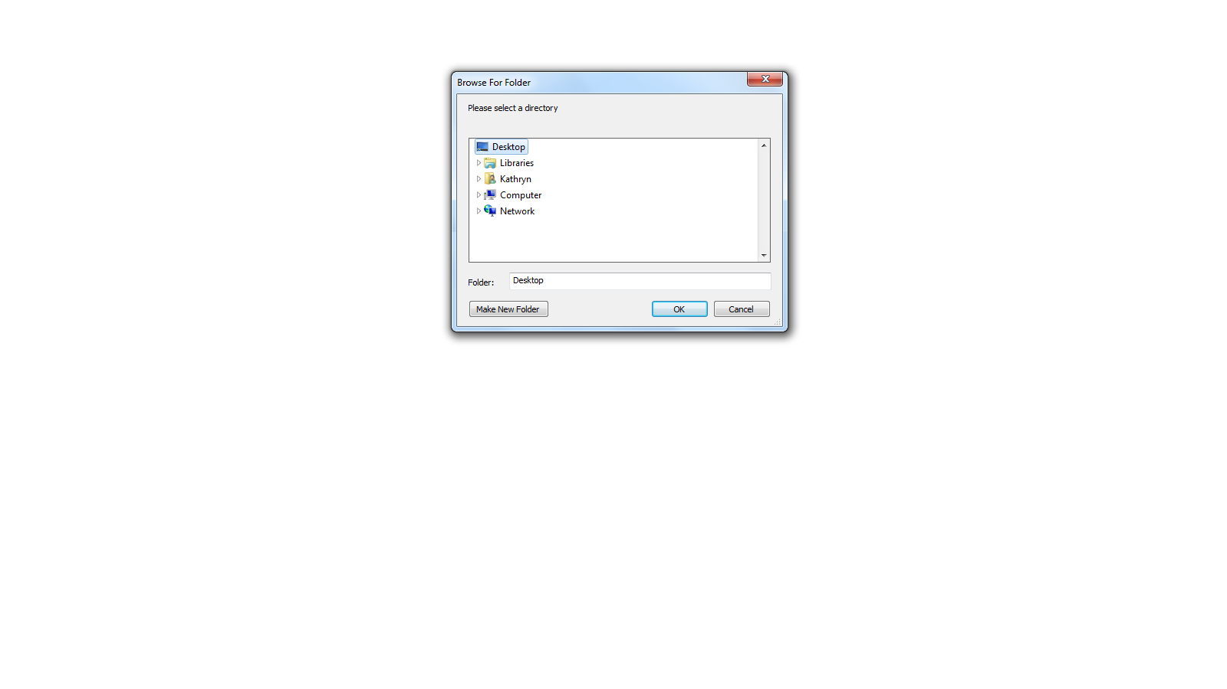
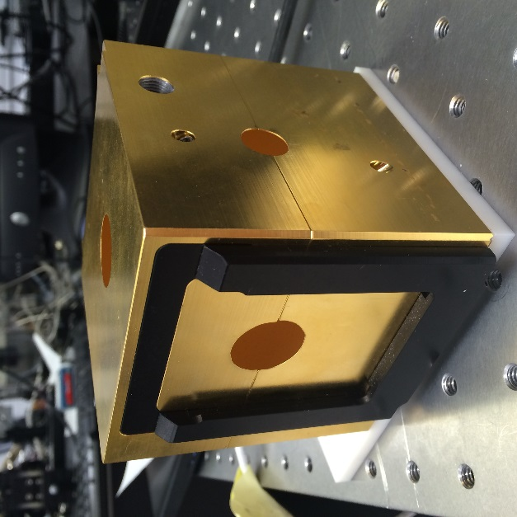
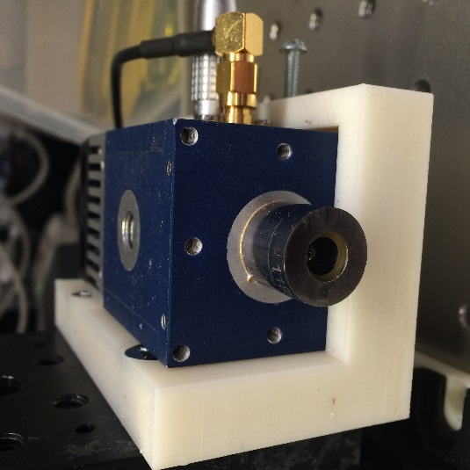
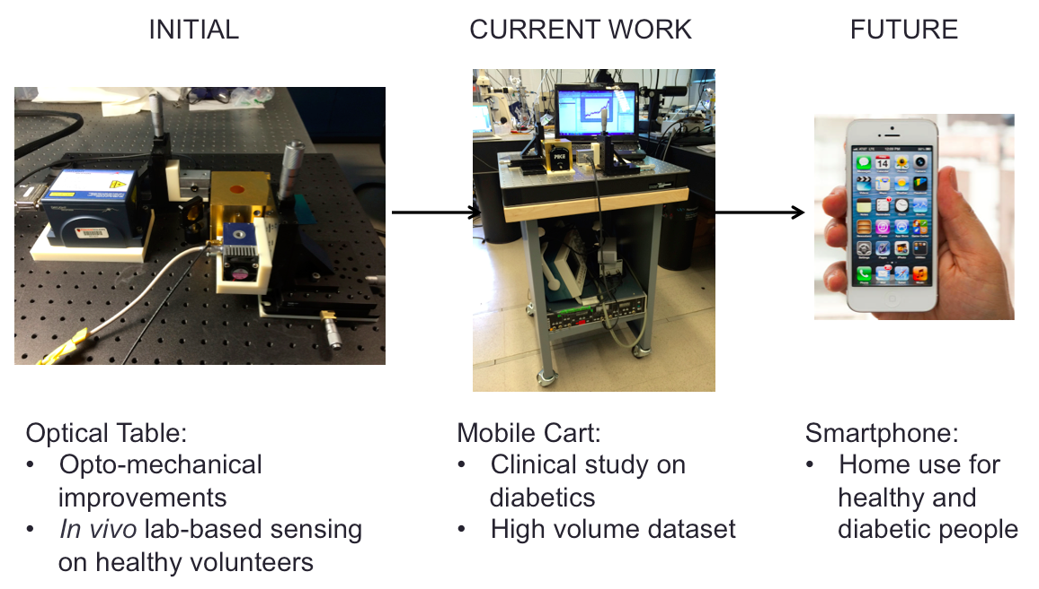

Python and GUI Implementation for Internal Optimization and Increased Usability of in vivo Glucose Sensing System
Kathryn DiPippo^{1,2}, Alex Werth¹, Michelle Zhang^{1,3}, Phillip Heucke^{1,4}, Jessica Doyle^{1,5}, Claire Gmachl¹
1 – Princeton University Department of Electrical Engineering, Princeton, NJ, 08540, USA
2 – Permanent Address: Rensselaer Polytechnic Institute, Troy, NY, 12180, USA
3 – Permanent Address: Smith College, Northampton, MA, 01063, USA
Industry / Practitioner Collaborators: Daylight Solutions Inc. Zurich Instruments
4 – Permanent Address: Bucknell University, Lewisberg, PA, 17837, USA
5 – Permanent Address: Hunterdon Central Regional High School, Flemington, NJ, 08822, USA
email: dipippo@princeton.edu / dipipk@rpi.edu
Introduction
GUI Design
Code Conversion and Examination
- Diabetes afflicts 9.3% of the entire
United States population, remains “the 7th leading cause of death”, by to 2014 statistics
- Diabetics must monitor their blood glucose
levels to ensure they stay healthy and
administer insulin if needed
- Goal is to enhance mid-infrared Quantum
Cascade Laser based non-invasive glucose
sensor to provide an alternative to obtaining
direct blood samples multiple times per day
to measure glucose levels.
The GUI itself was designed to feature two different modes: one for use with clinical trials and one for use in the lab.
CLINICAL TRIALS VERSION
More simplified design
Data stored in text files for later analysis regarding the patient
Python files needed after conversion
Prior MatLab code contained functions compatible with currently defunct systems and was not properly maintained with comments and structure
Photo Credit to: https://loonylabs.files.wordpress.com/2014/08/blood-sugar.jpg?w=590&h=392
Setup and Method
Libraries and variable initialization
The backscattered light from human wrist is collected by an integrating sphere and directed into a TE-cooled detector. The signal from the detector is used to predict the concentration of glucose in the subject’s blood.
Data collection function
Zurich Instruments data polling function; reads in scattering signal from detector
Dummy loading bar function
Dummy loading bar that lasts for 10 seconds while data is being taken.
MatLab files needed prior to conversion
Schematic of the sensor design consisting of a QCL, gold coated integrating sphere with three ports, and a TE-cooled detector.
IN-LAB, “SOLUTIONS" VERSION
Function that plots graph of input data
GUI layout function (Clinical version shown)
- Designed for more variable
manipulation
- Allows for altering signal
processing values
- Options to alter the data
processing steps
Directory related functions
Rewritten code in Python allowed for:
prior defunct functions to be removed
Structure within the code to be established with comments
additional libraries associated with python to be utilized (ex. Tkinter GUI library)
EC-QCL produced by Daylight Solutions, Inc.
Light pulsed at 55 kHz with duty cycle of 1%
Scanned between 1020–1220 cm⁻¹
QCL
All dates are taken using the Python time library, meaning they are automatically printed in entry boxes at startup.
MAIN
Gold coated
Sphere diameter of 7.62 cm
Port diameters: Input -> 3 cm, sample -> 2.5 cm, output -> 1.5 cm
Current Python code in use for the clinical GUI. It measures less than 400 lines and performs all the functions of the prior long MatLab Code.
Integrating Sphere
Future Plans
TE cooled MCT detector
Mobile
Specific detectivity of 10⁹
Opens folder dialogue to select where the data will be saved and retrieved.
- Optimize and miniaturize the three key components and place in mobile
case for clinical trials to increase the throughput and mobility.
- Integrate the code for real-time data analysis into GUI to produce the
scattering data along with the prediction in minimal time
- Soon, we hope to bring our mobile sensor into clinical trials at
diagnostic labs to obtain datasets from diabetic users.
Detector
“Load Data” runs the dummy loading bar (above). “BEGIN SENSING” takes the data. These are to be pressed simultaneously.
- GUI started up and populated with data
- Number of spectral runs are taken
- Various statistical analyses applied:
- Wavelet transform
- Savitzky-Golay Filtering with Differentiation
- Machine Learning Prediction Algorithm
- Final predicted glucose concentration
obtained
Partial least squares regression
Accuracy increases with number of calibrations
Depends on linearly proportional metrics
“Exit” safely quits the application.
Spectral Analysis
Michelle Zhang designed and implemented a real-time analysis calculation code, which once completed for Python will be integrated into the GUI code to display an estimate value.
We would like to acknowledge the Wendy and Eric Schmidt Foundation, the National Science Foundation (Grant No. EEC – 0540832), and Daylight Solutions, Inc. in San Diego, CA for their
vital contributions to this research.
This material is based upon work supported
by the National Science Foundation
under Grant No. EEC-0540832.
www.mirthecenter.org

